Slide 1
Assignment 2 Presentation

Slide 2
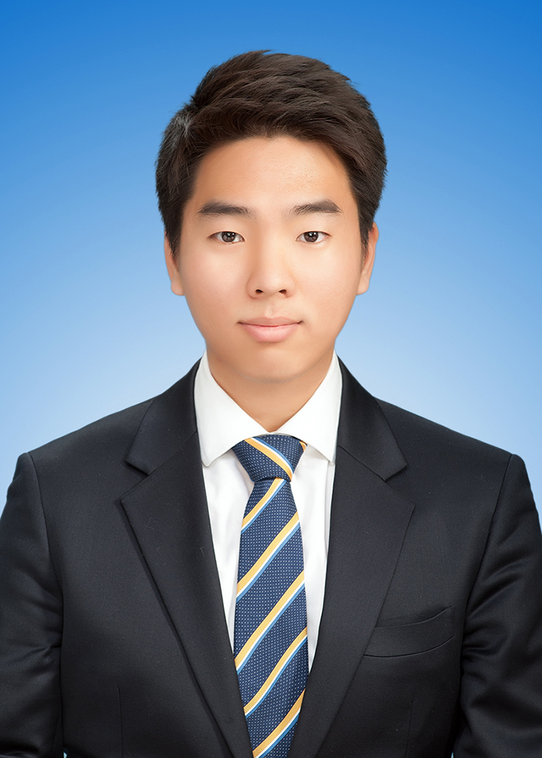

Group Tue 12i - Members
John (Min Jae), Kim
MinJae.Kim@anu.edu.au
Si Bo, Hu
u7271125@anu.edu.au
- Code structure design
- Back-end design
- Code structure design
- Front-end design

Slide 3
Table of Contents
Design Approach
Starting Game
Game Playing
Further Improvements

Slide 4
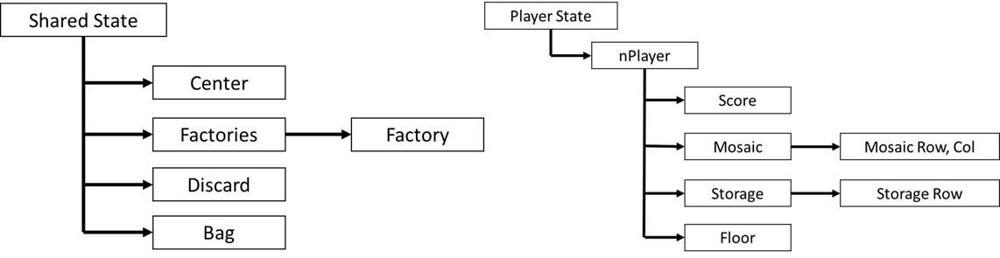
Design Approach

Slide 5
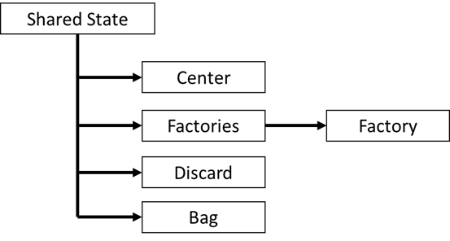
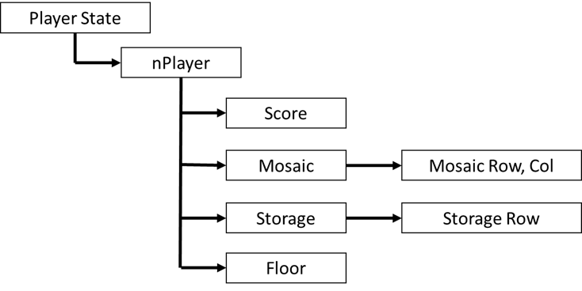
Design Approach
Well defined structure and object
Shared State
Player State

Slide 6
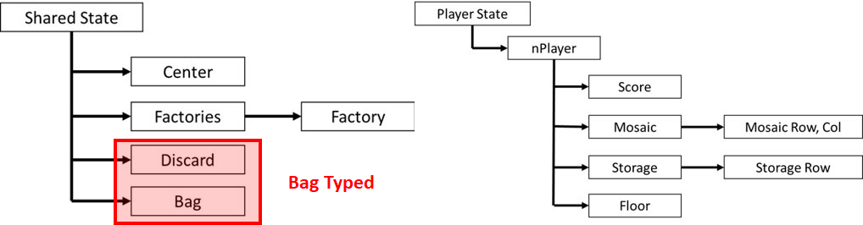
Design Approach
Well categorized object type
Bag typed : number of tiles
Tiles stored like "1215080914"

Slide 7
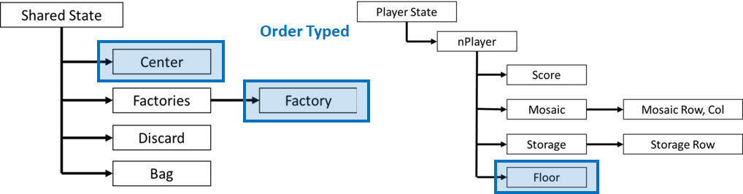
Design Approach
Well categorized object type
Order typed : color of tiles
Tiles stored like "aaabbbccdd"

Slide 8
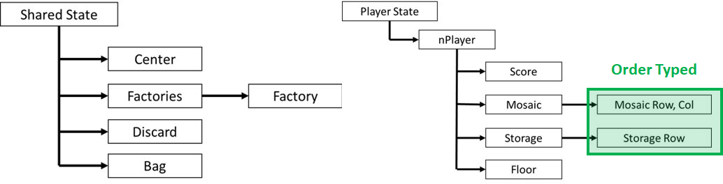
Design Approach
Well categorized object type
Coordinate typed : position of tiles
Tiles stored with color and specific position

Slide 9
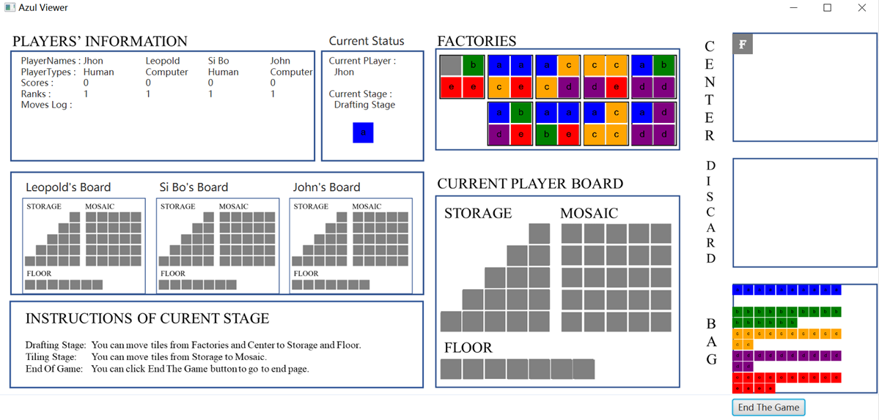
Starting Game

Slide 10
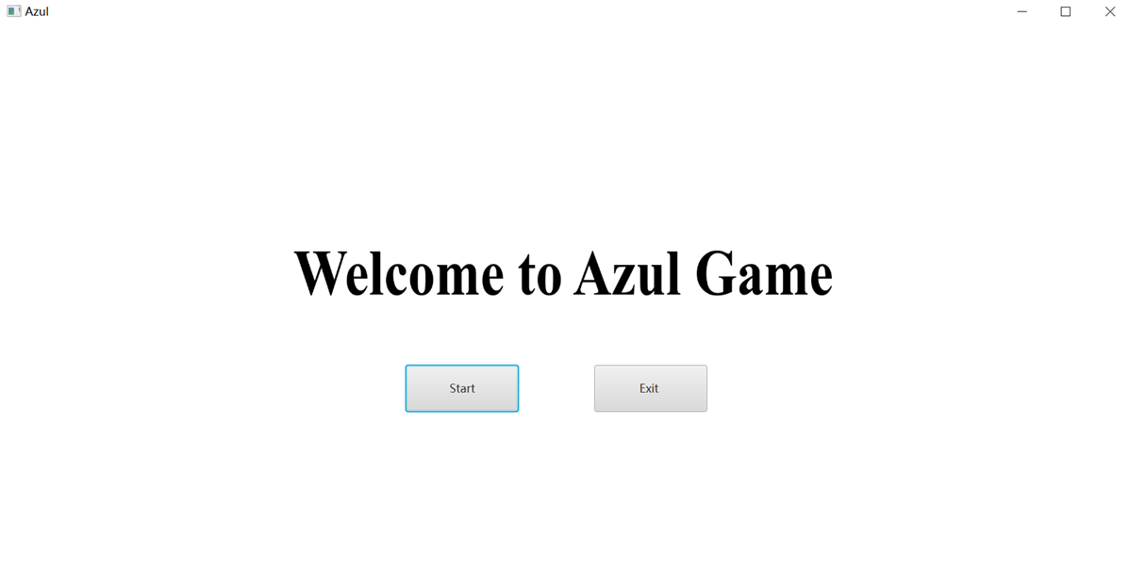
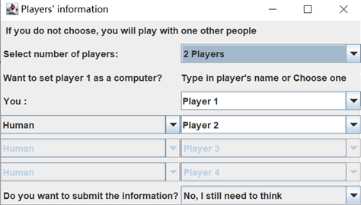
Starting Game
Game Start
Starting Page
Player Setting

Slide 11
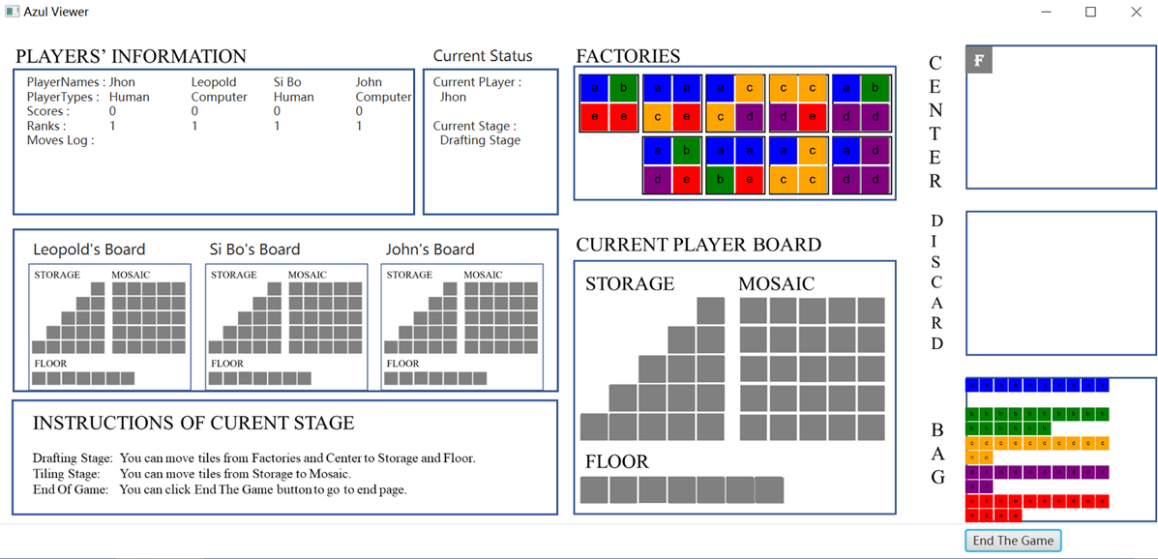
Starting Game
Three main parts of Azul Viewer
Player's Information
Other Players' Board
Current Player Board

Slide 12
Starting Game
Player's Information
Player Names
Player Types
Scores
Ranks
Move
Current Status
Current Player
Current Stage
Drafting Stage
Tiling Stage
End of Game

Slide 13
Starting Game
Other Players Board
Each players status
Not snappable
Only display
Current Players Board
Snappable or draggable

Slide 14
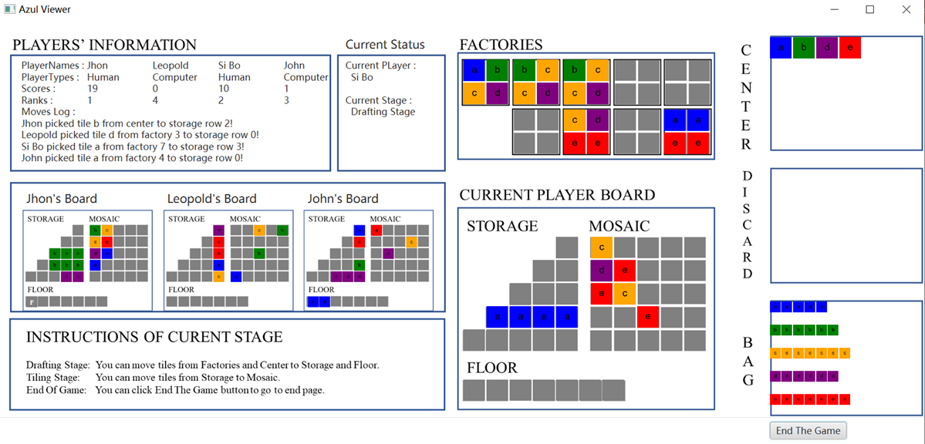
Game Playing

Slide 15
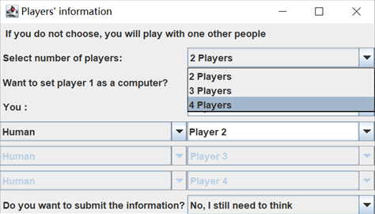
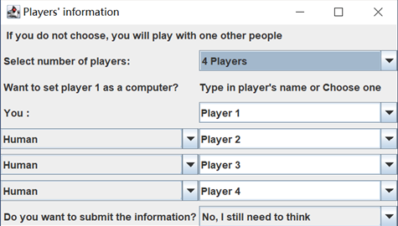
Game Playing – Player Setting
Select number of players
3rd, 4th player setting enabled

Slide 16
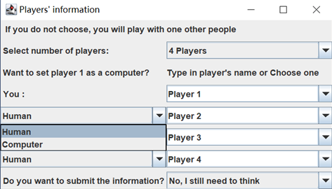
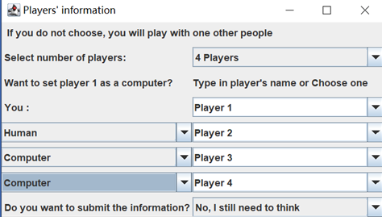
Game Playing – Player Setting
Select type of players
Setting for each players

Slide 17
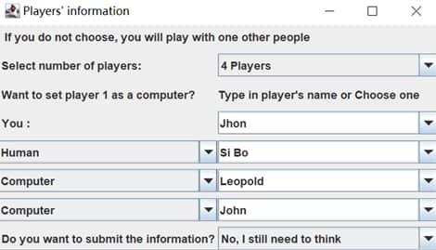
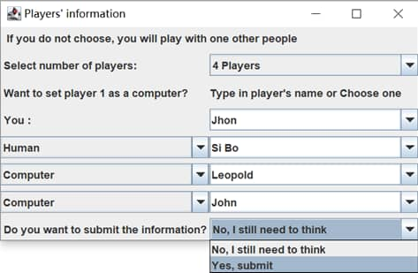
Game Playing – Player Setting
Type in name of player
Finalize setting

Slide 18
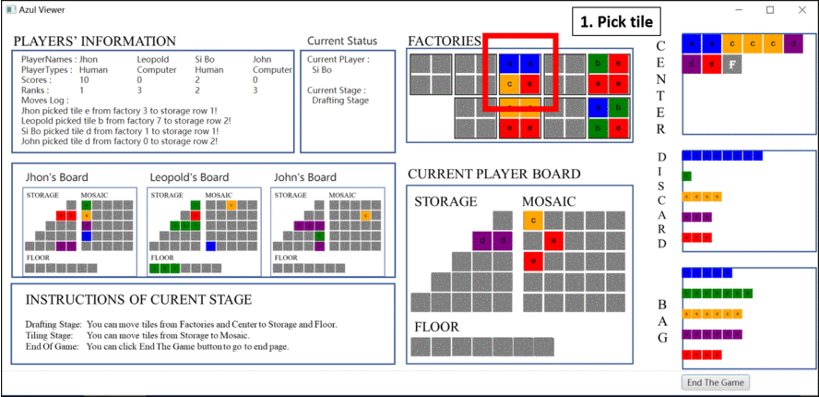
Game Playing – Drafting Move Restore

Slide 19
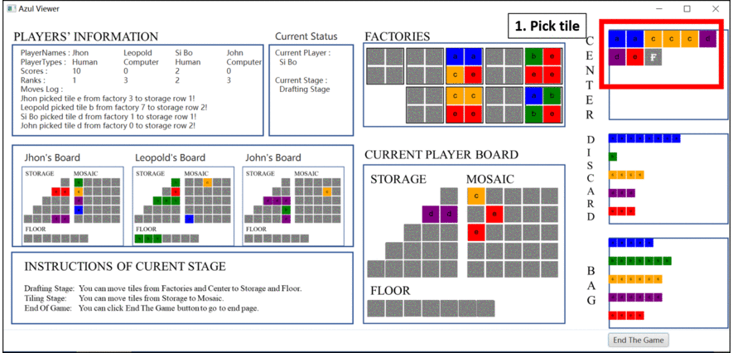
Game Playing – Invalid Drafting Move

Slide 20

Game Playing – Valid Drafting Move

Slide 21
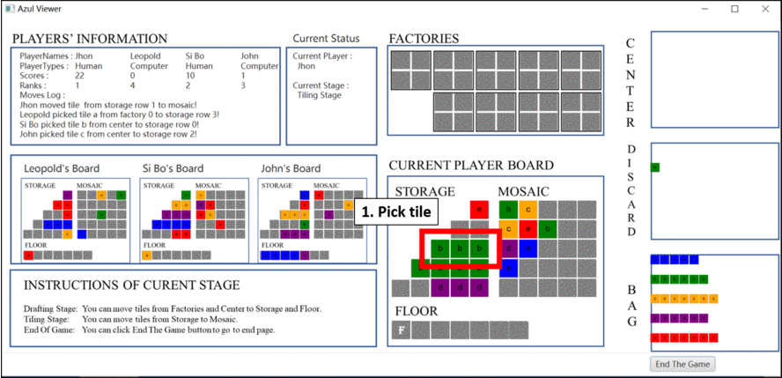
Game Playing – Invalid Tiling Move

Slide 22
Game Playing – Valid Tiling Move

Slide 23
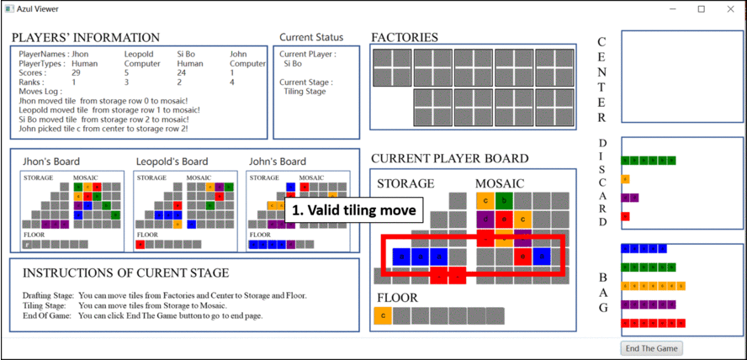
Game Playing – Preparing Next Round

Slide 24
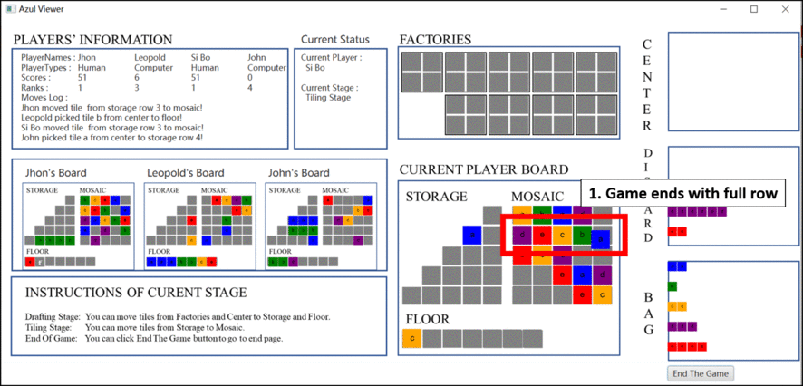
Game Playing – End of Game

Slide 25
Further Improvements
c
b
A's
Smart
Move
e
e
e
e
Pruning

Slide 26
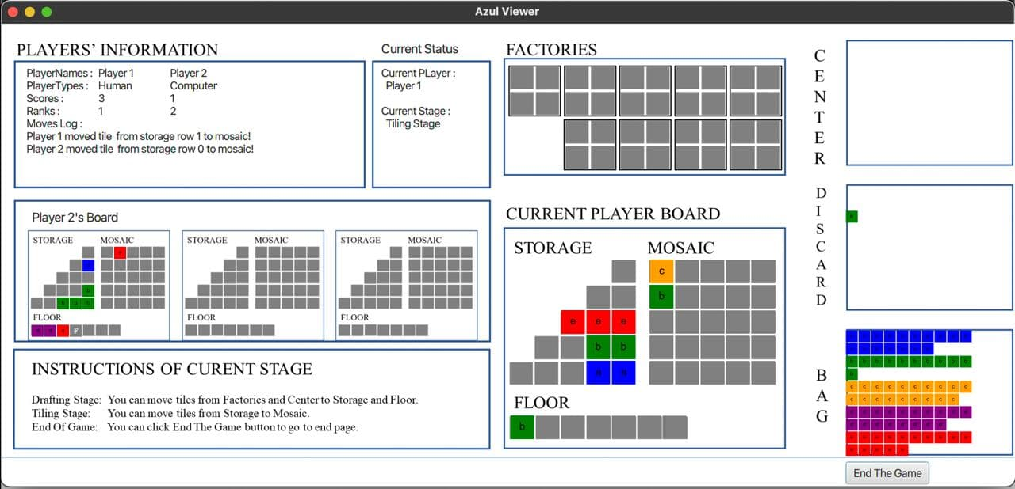
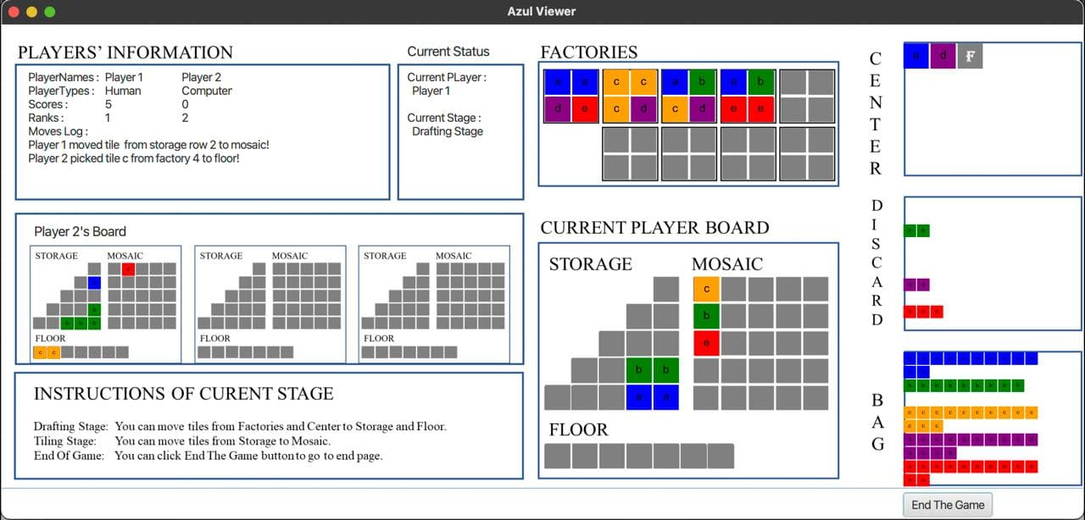
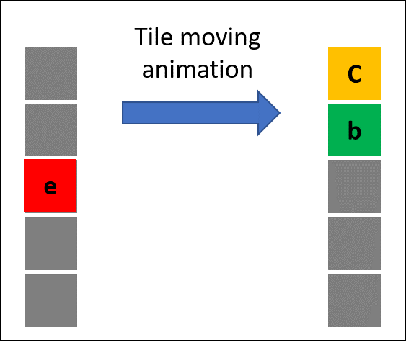
Further Improvements
Enhanced user interface
Show tile movement from start to the end

Slide 27
Further Improvements
Enhanced computer opponent
Make tree of every possible movement and calculate score
Use recursive method to find smart move
A's
Highest
Score
A's
Smart
Move
...
.
.
.

Slide 28
Further Improvements
Enhanced computer opponent
Advanced search algorithm with alpha-beta pruning algorithm
A's turn
Maximize A's Score
Minimize A's
Score
Not A's turn
Minimize A's Score
Maximize A's
Score
A's
Possible
Highest Score
A's
Smart
Move
...
.
.
.
Pruning

Slide 29

Questions and Answers

